Slide 1


About me
Abdullah Al Talaq
Training Duration
Domain
Major
Mentor
6 months
Manufacturing
Artificial Intelligence
Hamza Shafi

Slide 2





About me
Reached final contest in Saudi CPC
Achieved Security+ Achieved Ejpt Reach finals ctf in BlackHat
Graduated in AI major

Slide 3
Trainee Journey
Main Goal | Activities / Achievements
Completed goals | Complete Data Engineering and Machine learning Professional courses
 | Complete Data Engineering and Machine learning Master courses
 | Assets Health Care (AHC) project
 | Unified Testing GENAI
Soft skills | Teamwork
 | Agility
 | Adaptability
Research Topics | Anomaly detection for time series
 | Unsupervised leaning
 | RAG
PLAN FOR UP COMING WEEKS :
Enter different domains
Try AI subfields
Hidden

Slide 4
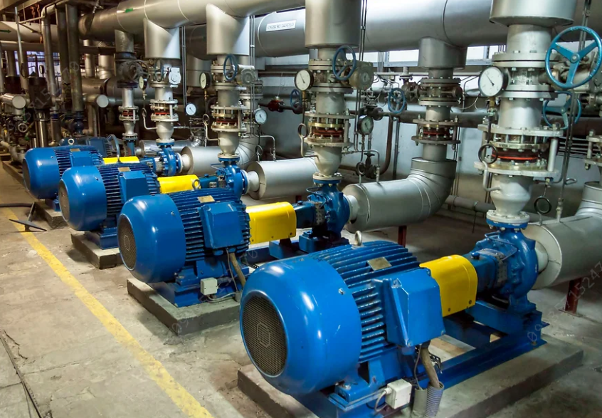

Assets Health Care (AHC) project
The objective is to capture all the anomalies in asset’s sensor groups at the provided period.

Slide 5
Assets Health Care (AHC) project CHALLENGES
Remove Offline Condition of KM.KOP.US100sensor
An Anomaly is abnormality in the data for at least 2 hours period
Read multiple articles for anomaly detection in time series

Slide 6
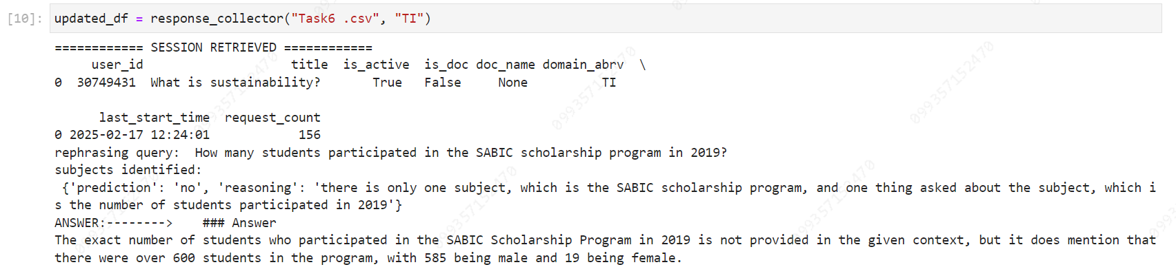
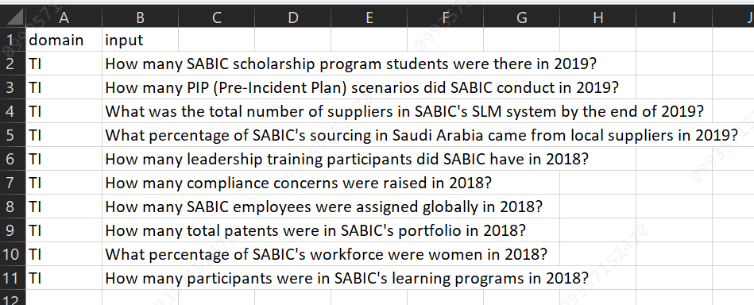
Test GenAI
Test GENAI is responsible for testing multiple questions in specific field like HR, TI, EPM

Slide 7
Learning outcomes
LEARNING OUTCOMES
CHALLENGES
Send simple, Pro, Polite, Emails
Requests waiting
Learn more AI concepts
RapidMiner boundaries
Learning New Tool (RapidMiner)
Adapt to company’s environment

Slide 8
Thank you
Notes:
To select different Thank You options, go to HOME tab and click Layout button.

